Slide 1
Notes:
So why are we going to spend an entire quarter talking about Evolution in a bible class? Why should something like Evolution and science occupy so much of our time? This will be a theme verse for us throughout our study:
1 Pet 3:15 – “But sanctify Christ as Lord in your hearts, always being ready to make a defense to everyone who asks you to give an account for the hope that is in you, yet with gentleness and reverence”
As Christians, if we are going to be ready, if we’re going to make a defense, if we’re going to give an account of the hope that is in us, we must know what it is that the world is attempting to do to undermine faith in God and develop the critical thinking necessary to adequately fight against it.

Slide 2
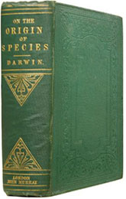
What Got Us Here?
Notes:
How did we get here? Why has Evolutionary Theory become a worldview with which we find ourselves having to contend? It was a 2-prong thrust:
The first prong was begun by certain individuals within the humanistic community in Western Europe, who in the 18th century began propagating liberal theology designed to undermine credibility in the bible. This “Age of Enlightenment” had a very scientific thrust that attempted to usher God out of the picture and to instead make humanity, in essence, the only god. But it couldn’t gain the popularity its proponents desired at the time because there was no scientific hypothesis firm enough in their mind to take their objective to its ultimate conclusion of explaining origins naturalistically.
But then the second prong came in the form of Evolutionary theory, an effort made to nullify 1000s of years of teaching that proposed we came from an Intelligent Designer. For the last 150 years, since the publication in 1859 of Charles Darwin’s book “On The Origin of Species”, the humanistic and naturalistic community has pushed this theory of Evolution, the hypothesis that every single one of us evolved from microorganisms, what is sometimes called “molecules to man” Evolution or “Macroevolution”.
This doctrine of Evolution is FAR from an unbiased attempt to discover the origins of man. Rather, it was purposefully designed as an alternative to faith in God. This is not Ryan Hasty’s opinion on this; it is historically documented and I’m going to share with you later on some quotes by famous Evolutionists acknowledging this fact.

Slide 3
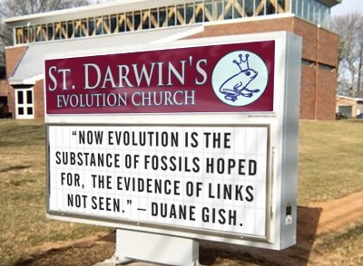
Where Are We Now?
Which denominations
accept evolution?
Anglican
Episcopalian
Presbyterian
Methodist
UCOC
Lutheran
Notes:
Well where are we now? For the past 150 years, bible believers have had a lot of pressure put on them to accept this Evolutionary hypothesis and many have given in and bought into it to such a degree that even denominational churches are either denying the bible’s teaching on Creationism outright or attempting to compromise with the secular world by twisting the Genesis account to insert evolutionary hypothesis, what is called Theistic Evolution, which we will be discussing in great detail down the road.
How much has this infiltrated the denominational world? The Anglican church, Episcopal church, Presbyterian church, Methodist church, United churches of Christ, Lutheran church, etc. have embraced both humanistic theology and the theory of Evolution. And as they’ve done so, they’ve seen their numbers plummet as it has caused their members to ultimately lose their faith in God’s written word. Because, as we’ll discuss again down the road, if you can’t accept the Genesis account, than why accept the flood? Why accept other miracles? Why accept the resurrection of Jesus Christ? It’s a slippery slope.
Back in the early 1800s before all this Evolution stuff started taking root, one statistic said that 90% of people in England went to some church. But then by 1938, at the beginning of WW2, only 45% of people went to church. Today, that number is down to 7% of people. In other words, everything that happened in Western Europe transferred over to England and now it is happening in America. And that is why we need to be ready to counter it, to give an answer, to make a defense, and to fortify our own faith.

Slide 4
Don’t Dismiss This Topic!
“The bible teaches that anyone who says ‘There is no God’ is a fool and that’s all I need to know!”
Notes:
But here’s one of the issues I face teaching on this subject. Its this guy right here. I’ve been teaching on Christian Evidences for years. And when I’m asked to present it in lectures and at gospel meetings, it is inevitable that someone from the older generation will scoff at me for spending so much time on it. And here’s what he’ll say – “The bible says that the person who says there is no God is a fool and that’s all I need to know”. Well, Psa 14:1 does say that and good for him for not just being able to quote your bible, but for believing what he’s quoting.
But you know what I say to the older generation who doesn’t get this? “I’m not as concerned about you, sir”. I’m not as concerned about the older generation when it comes to evidences and evolutionary teaching. Those who I am primarily concerned about are you guys, and those sitting in high school, middle school, and elementary classes. I’m concerned about what is happening to the children that are being taught Evolution in the public school system and then get whisked off to public universities where not only are you guys still being taught this stuff, but you’re browbeaten with it and surrounded by millennials who look down on you for saying otherwise. Am I right?
So what I’d say to the older generation or any others who think similarly to this guy – “Don’t dismiss it. You have no idea how much evolutionary propaganda is destroying Christian faith.”

Slide 5
We Are Losing Our Youth
1 Cor 1:18 – “For the word of the cross is foolishness to those who are perishing, but to us who are being saved it is the power of God.”
Notes:
Here is what I’m worried about: members of the Lord’s church are losing their faith every day due to Evolutionary teaching. I have known a number of Christians who have fallen away into agnosticism and accepted Evolution, including men I knew who were preachers of the gospel. Earlier this year at a gospel meeting, I was urged to speak to a family who used to be members of that church who drifted into Atheism because of Evolutionary teaching.
Richard Dawkins, who is the most outspoken Atheist in the world, used to be a believer. But then he was converted to Evolutionary thought. These are people who decided to put their faith in science rather than God. But as we’re going to discuss in just a moment, they’re not really putting their faith in science. They are putting faith in the scientists themselves who use big words, big phrases, speak in technical ways that bring about “oohs” and “ahhs” within those who are impressed by their words and rhetoric. Therefore they are falling for their lies hook line and sinker.
Too many Christians, because they don’t want to be seen as out of touch, are wanting to make themselves look noble in the eyes of the scientific community. And if your disposition as a Christian is to avoid at al costs getting mocked and scoffed at, you’ve already taken the first step toward losing your faith. 1 Cor 1:18 – “For the word of the cross is foolishness to those who are perishing, but to us who are being saved it is the power of God.” We cannot walk in the footsteps of Jesus without being looked down on by others. Its part of the price we pay for our redemption.

Slide 6
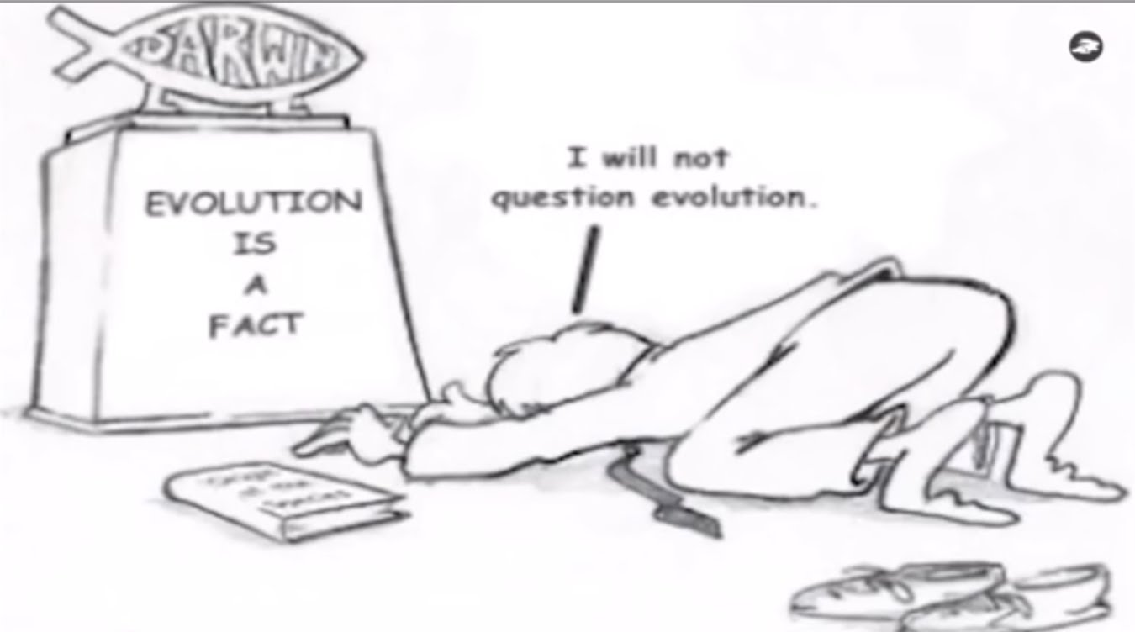
Scientism
Scientism is simply an exaggerated belief in science. Scientism claims that the method of modern natural sciences provide out only access to the world and give the only kind of truth.
Notes:
One of my goals throughout this series will be to show you that scientism is not a valid explanation for our origins. Scientism is the belief that all things can be understood by scientific inquiry. And in the western world, this is what many people think, that science is the pinnacle of all knowledge, that all we have to do is put it in the test tube and prove it. You can’t do that, and for a lot of reasons, some of which I’m going to show you in this lesson – scientists are fallible human beings, many of them interpret data under biased pretenses, and they are wrong all the time and have been proven to be wrong for hundreds of years
My goal in this series will also be to show you that God has given us the answer to our existence in His word. For those of you who are worried this class might get too technical and not enough scripture based, that will not be the case. We’re going to try to be balanced. But we need to understand that science doesn’t have all the answers, so what we’ll do is take the Creation model, which says that God created the heavens and the Earth in 6 days, and then we’ll take the Evolutionists model which states that a single-celled organism from 3.8 bullion years ago formed and then evolved into what we see today and we’re going to compare them.
These are two valid hypotheses, right? We take these 2 models, go out in nature and observe things, read what God’s word says, and determine which model is more valid. And when you approach these two hypotheses in this way, you will absolutely find that the world we live in fits the Creation model. That’s my proposition.

Slide 7
Common Arguments
“I believe Gen 1. But I can’t believe the world is young.”
Notes:
The problem we run into is that people are making arguments they haven’t really thought through. These are just a few of the arguments you hear when science becomes our “god”:
1. I believe Gen 1, but I just can’t believe the world is young
And I always answer this question with a “Why not?” And you know what the answer to that question? Because people who make this argument are watching too much National Graphic, too much Discovery Channel, too much History Channel, and not reading enough of their bible. They’re not learning to think for themselves. They’re listening to the talking heads on these TV channels and they’re not doing any thorough investigation of their own. This isn’t their belief because they’ve been out there doing their own investigation. This person believe it because they listen to the so-called scientists.
Illustration – Restoring Tracy
But did you know there are many, many scientists who believe in Creation? More on that later.

Slide 8
Common Arguments
“Why are you bringing us back to the dark ages? If we did it your way, we’d all believe the earth was still flat, we’d be without cars, electricity, running water, etc.”
Elephant
Hurling
Richard Dawkins – “The evidence for evolution is overwhelmingly strong and I am passionately distressed that my opponent can't see it.”
Walter Remine – “More to the point I am passionately distressed that you can [see it]!...what about the overwhelmingly weak (actually zero) evidence for transitional forms between pre-Cambrian and Cambrian?” (Allen, Keith, 2012, The God Conclusion. Houston: Strategic Book Publishing. p. 94)
Notes:
2. Why are you bring us back to the dark ages? If we did it your way, we’d be without cars, electricity, running water, etc.”
Now this is a common tactic not just of Evolutionists, but of skeptics in general – a logical fallacy called elephant hurling. They throw everything at you but any actual proven, scientific facts.
One example of this is in Keith Allen’s book called “The God Conclusion”. He shows the use of an elephant-hurling by an Evolutionist (I believe it was Richard Dawkins) who was debating a Creationist by the name of Walter Remine. Richard Dawkins said, “The evidence for evolution is overwhelmingly strong and I am passionately distressed that my opponent can't see it”
Walter Remine responded, “More to the point I am passionately distressed that you can [see it]!...what about the overwhelmingly weak (actually zero) evidence for transitional forms between pre-Cambrian and Cambrian?”
When you’re giving a defense against Evolution, be sure to call people on the supposed evidence for Evolution they say strongly claim to support and look down on you for. The ability to shake our head at someone else’s belief does not equate to evidence itself.

Slide 9
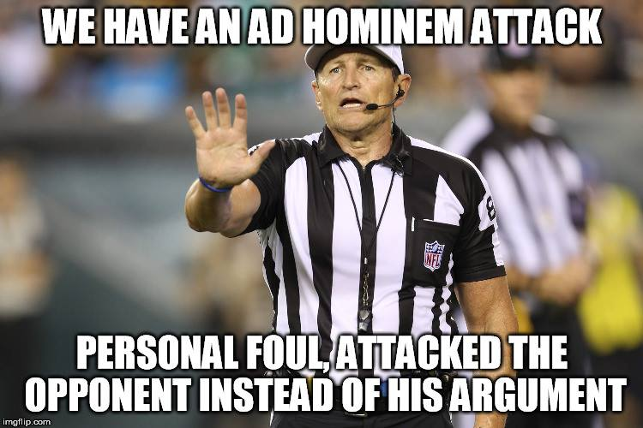
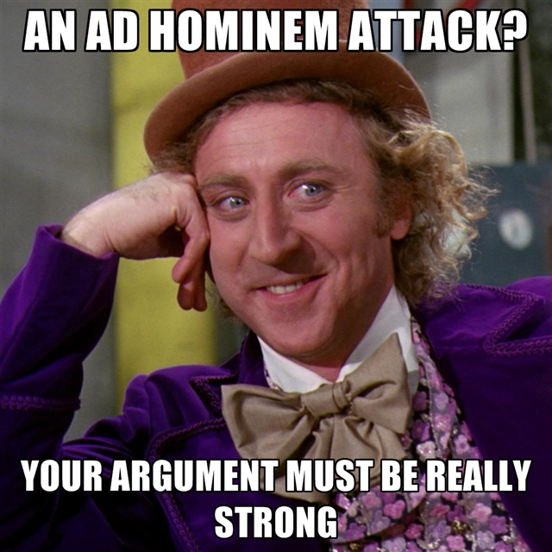
Common Arguments
“I anyone had a brain, they’d listen to science and not 4000 year old stories written by goat herders.”
Notes:
3. “I anyone had a brain, they’d listen to science and not 4000 year old stories written by goat herders.”
This is a common Ad Hominum attack where rather than just laying out the evidence, a skeptic will attack the character of the one who opposes his position.
Listen, we don’t have to go back 4000 years to show where science has been proven wrong. We only have to go back 4 years. In a few moments, we’re going to look at some of the things science published as fact that was later rebuffed and had to be recalled. And if we looked at the complete list, it would be long indeed.
But I have no problem asking this same person to show me a story in the bible that is not true based on scientific, geological, or historical evidence. I’m up for that challenge. I may not be able to answer it the very moment it is presented, but give me a day of research and study and I will have the answer.

Slide 10
Common Arguments
“Christians want to reject science! They are anti-science!”
Notes:
If you’ve engaged in discussion with Evolutionists at all, you probably already know that Creationists are labeled as “anti-science”. This couldn’t be further from the truth as later on we will show there are a plethora of scientists in every field imaginable who believe in Creationism as a result of firm study, research, and extensive field work.
The issue between the evolutionist worldview and the creationist worldview will always be driven by how we interpret the evidence. If I am biased in either direction, I will accept the direction to which I am biased. But only the one who interprets the evidence with an honest, open heart, having looked at both sides of the issue, will arrive at the correct conclusion, whatever that conclusion may be. And either conclusion can only be accepted on basis of faith through reasoning.
The other trick skeptics try is making a distinction between “faith” and “science”, a false dichotomy since some faith is required to believe in either worldview. Creation and Evolution, whichever one is true, are unrepeatable pasts not observed by humans and therefore both fall under the category of Historical Science rather than Observational Science (which can only occur empirically within a laboratory).

Slide 11
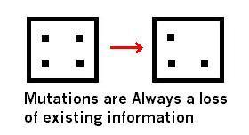
Common Arguments
“Christians want to reject science! They are anti-science!”
Notes:
So what are Christians rejecting exactly when it comes to Evolution? We’re not rejecting science, we’re not even rejecting changes within kinds in nature, what are called micro evolution type changes. What we are rejecting is molecules to man evolution, what is called Macroevolution.
And, follow me here, there is no known observable process by which new genetic information can be added to the genetic code of an organism. Absolutely none. There is no observable process to show how a fish can have genetic information added to it to become an Amphibian. Nothing can evolve into a higher form, higher intelligence, higher complexity without this new genetic information added. What we have been able to observe is that humans are humans, fish are fish, etc.
Secondly, life has never been observed to come from non-life and Louis Pasteur, a brilliant scientist, proved this decades and decades ago.
So it begs the question of which worldview is actually rejecting science? Something to think about.

Slide 12
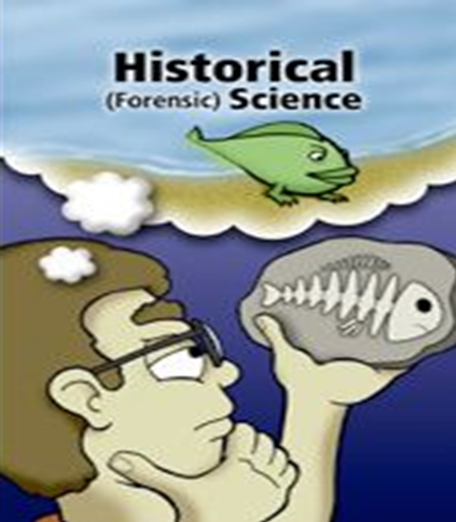
Common Arguments
“Christians want to reject science! They are anti-science!”
Notes:
There is a big difference between observational and historical science. They both serve a purpose, but both are completely different.
Observational science is when we observe something and experiment with it in order to draw conclusions. It must be concluded through repeatable experiments. This is how we find cures for diseases, and build space shuttles to land on the moon, etc. This is where Francis Bacon’s scientific method came from where he claimed something must be testable, repeatable, observable, and falsifiable in order to be proved scientifically.
But with Historical Science, we consider things that happened in the past but they cannot be verified in the same way as Observational Science because we don’t have access to the past like we do in the present. All we have is speculation or circumstantial evidence of past events based on what we see in the present. This doesn’t mean we can’t make reasonable inferences about the past from things like fossils in the present, its just that we cannot directly test our conclusions because we cannot repeat the past.

Slide 13
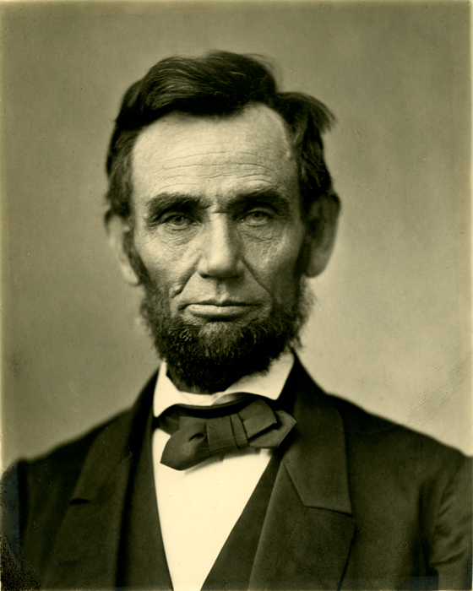
Common Arguments
“Christians want to reject science! They are anti-science!”
Notes:
Example: Who is that good looking guy right there? How do we know Abraham Lincoln exists? Well, if we know where he is buried, we might could dig him up. How do we know he was tall? We could measure his corpse and take into account rates of decay and things like that.
How do we know, though, that he was 16th president of the Unites States? How do we know he issued the Emancipation Proclamation? How do we know he led the Union to victory in the Civil War? Well, we discover what has been communicated to us through historical documents and eye witness accounts. We also believe those eye-witness accounts are trustworthy.
And that is exactly why we don’t believe that Abraham Lincoln was truly a vampire hunter, right? It’s edgy, it’s hip, and pop culture approves. But there is something lacking in its credibility, right? It’s a sensational view, it stimulates the imagination, and its fun to think about the possibility, but its not based on anything other than a film writer wanting to make a quick buck, right?

Slide 14
Common Arguments
“Christians want to reject science! They are anti-science!”
Order/Logic
Comprehension
Laws
Psa 19:1-2 – “¹The heavens are telling of the glory of God; and their expanse is declaring the work of His hands. ²Day to day pours forth speech, and night to night reveals knowledge.”
Notes:
But what about Creationism? Is there enough evidence in the world/universe by which we can observe that might lead us to the conclusion that there is a Creator?
Observational Science – what we sometimes called “general revelation”
We observe that the universe is orderly and logical, which only makes sense if its Creator is orderly and logical and therefore imposed order on His creation. This order does not make sense at all if the universe were merely an accident as a result of some explosion – that would only produce chaos.
Second, our minds are able to comprehend many things about the universe which is only possible if the Creator of the mind gave us both an ability and a desire to explore the universe. If our brains are simply by products of chemicals and chance, we could never even trust our brain’s conclusions to be accurate.
Third, it only makes sense that we can observe and repeat an experiment if our universe consistently obeys its own laws from day to day, which only makes sense if the Law Maker created it that way and sustains it that way.
In the Creationism worldview, this is what we call “general revelation”. Psa 19:1-2 – “The heavens are telling of the glory of God; and their expanse is declaring the work of His hands. Day to day pours forth speech, and night to night reveals knowledge.” David is saying that when he looks out into the world and truly considers it with its billions upon billions of its intricate features, it literally shouts of a Creator.
Therefore, Christians are not anti-science. We’re reasoning through our observations in what we see in the universe, and what we believe we see is design.

Slide 15
Common Arguments
“Christians want to reject science! They are anti-science!”
Gen 1:1 – “In the beginning God created the heavens and the earth.”
Dead Sea Scrolls
Handwritten copies
Fulfilled Prophecy
Archeology
Scientific Foreknowledge
Laws of Evidence
Postapostolic Confirmation
Notes:
Historical Science – Trustworthy Documents that confirm it, what we sometimes called “specific revelation”
The bible teaches us that God was there in the beginning – Gen 1:1 – “In the beginning God created the heavens and the earth.” And it also tells us that He inspired certain men to write down His very words, words which became books collected together into a volume that we call the bible. It has demonstrated itself to be totally trustworthy in every single claim it teaches and secular scholars even concede that the bible accurately records historical events.
For the OT scriptures, we have the Dead Sea scrolls that date as early as 250BC, including 2 complete scrolls of Isaiah that date back to 125BC that not only prove the Jewish transcribers’ credibility, but can be compared to our current OT copies and be found to be within 95% accuracy with the other 5% predominantly being misspelled words and omitted letters.
For the NT scriptures, we have over 24,000 partial and complete hand written copies that date back as early as the 2nd century AD which are 99.5% accurate compared to our current versions. And we could take all 86,000 NT quotes from the writings of the early church fathers of the proceeding centuries and reconstruct the entirety of our NT minus just 11 verses.
We have fulfilled prophecy, declarations of coming events with enormous specificity and clarity made hundreds and even thousands of years beforehand that have come true, the most astonishing of which were the prophecies made concerning Jesus Christ.
Every single year, archeology uncovers more details about past events that collaborate biblical record and silence critics. Even William Ramsey, a former atheist, set out to disprove Luke’s records in his gospel and the book of Acts and upon tracing his steps, was so confounded by Luke’s accuracy that he became a believer.
The scientific foreknowledge of the bible will blow your mind, acute awareness of the natural world that the common man of those times could not possible have known that God revealed to them only to be first discovered scientifically thousands of years later.
The NT record passes all 4 laws of evidence that modern legal documents are put through in court rooms today to validate the legitimacy of its authors, and continues to pass with flying colors.
Post-apostolic Christian sources confirm it, Post-apostolic nonChristian sources confirm it, and men and women within that generation went to the cross, were burned alive, and torn apart by lions in the coliseum confirming the veracity of its truths.
All this means that we have the most trustworthy revelation from the most trustworthy eyewitnesses.
And this means that science itself, whether observational or historical, is only possible because God exists and the bible is true. And we’re just painting the surface. See, Christians are not the ones rejecting science – its Evolutionists that reject science by trying to turn hypothesis into science that cannot be observed.

Slide 16
Common Arguments
“How can scientists w/their great minds be so wrong?”
Matt 13:14-15 – “¹⁴In their case the prophecy of Isaiah is being fulfilled, which says, ‘You will keep on hearing, but will not understand; You will keep on seeing, but will not perceive; ¹⁵For the heart of this people has become dull, with their ears they scarcely hear, and they have closed their eyes, Otherwise they would see with their eyes, hear with their ears, and understand with their heart and return, and I would heal them.’”
Notes:
“Well how can scientists be so wrong? These are great minds you’re disagreeing with!” I’m going to show you in just a minute that there are many scientists with great minds that are Creationists, believers who confirm the authenticity of scripture.
But we need to understand that when Jesus rebuked the Pharisees, he never questioned their intelligence. Their refusal to accept Him was based on 3 things: blind eyes (refuse to see), deaf ears (refuse to hear), and hard hearts (refusal to accept). Their issue was not one of intellectual deficiency or ability; it was an issue of “will”. That has always been the case and will always be the case.
Two equally intelligent human beings can look at the same piece of evidence and come to radically different conclusions if one of them is not willing to be honest and let the evidence speak for itself and take him where it is naturally leading regardless of the consequences.

Slide 17
Common Arguments
“How can scientists w/their great minds be so wrong?”
“Scientists have discovered that people will believe anything when you claim scientists have discovered it."
1 Cor 8:1 – “Now concerning things sacrificed to idols, we know that we all have knowledge. Knowledge makes arrogant, but love edifies.”
Notes:
Here’s what we need to get across to people who want to fall down and worship scientists with their great minds. Scientists have been getting things wrong for hundreds of years. Theories are overturned all the time. Published scientific papers have to be recalled often.
In the 1600s, scientists said the sun revolved around the Earth.
In 1750, scientists said that fire was caused by the release of a substance called Phlogiston.
In the 1800s, scientists treated the ill by bleeding them. That’s how George Washington died.
“Well, technology has advanced now more than ever.” You think we’re finally there? If anything has reached its peak in mankind, it is our pride and not scientific advancement – that is ongoing. 1 Cor 8:1 – “Now concerning things sacrificed to idols, we know that we all have knowledge. Knowledge makes arrogant, but love edifies.”
Let me tell you the biggest discovery by scientists in the last 200 years. Are you ready? This is it – the biggest: Scientists have discovered that people will believe anything as long as you claim scientists have discovered it.

Slide 18
Common Arguments
“How can scientists w/their great minds be so wrong?”
Who? | Age of the Earth | When Was This?
Comte de Buffon | 78 thousand years old | 1779
Abraham Werner | 1 million years | 1786
James Hutton | Perhaps eternal, long ages | 1795
Pièrre LaPlace | Long ages | 1796
Jean Lamarck | Long ages | 1809
William Smith | Long ages | 1835
Georges Cuvier | Long ages | 1812
Charles Lyell | Millions of years | 1830–1833
Lord Kelvin | 20–100 million years | 1862–1899
Arthur Holmes | 1.6 billion years | 1913
Clair Patterson | 4.5 billion years | 1956
Isa 40:8 – “The grass withers, the flower fades, but the word of our God stands forever.”
Notes:
A lot of Christians start doubting the bible because some guy on TV or the internet says so. Some Evolutionist speaks in bold, big-word terms about something we don’t think we’re smart enough to contend with and then we shrink back and ultimately give in.
Listen, these guys have been changing their minds for centuries! If you were living in the 1950s, the age of the Earth has tripled. In fact, science books keep going out of print and being replaced with new editions because they can’t seem to get their hypotheses right.
Meteorologists can’t get their weekly forecasts right but I’m supposed to believe what scientists say happened 4.5 billion years ago? If they can’t get right what is going to happen 8 hours from now, how are they supposed to get right what happened 4.5 billion years ago? Perhaps our confidence is misplaced.
If we put our faith in science, saying things like, “We have to have a scientific answer for everything”, what happens when science fails us as it has so many times?
What will happen when/if communism takes root in the United States and we’re therefore not allowed access to the information that disproves Evolution and proves Creationism?
The bible does not change! Isa 40:8 – “The grass withers, the flower fades, but the word of our God stands forever.”

Slide 19
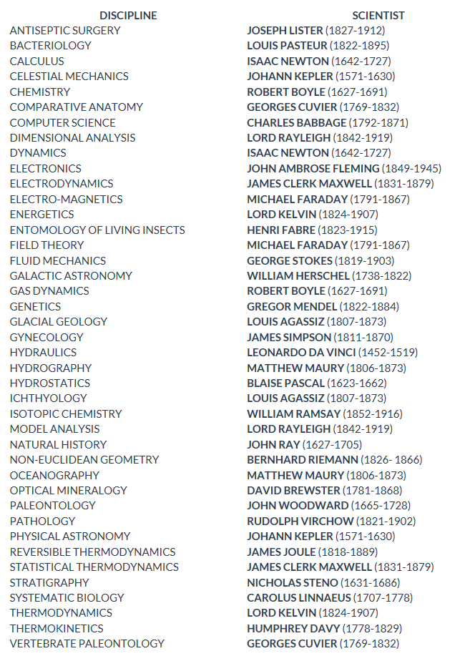
Creationist Scientists
Notes:
So many of those who have bought into the concept of evolution without doing their own homework don’t realize that there are thousands upon thousands of scientists who believe in Creationism. These are men who have great minds, big brains, tons of degrees and have saved millions of lives with their discoveries and inventions. These are men who have done their homework and believe emphatically in a young earth and dismiss evolutionary claims altogether.
This is short list of scientific disciplines established by creationist scientists. And we’re going to talk about a few of these men in more detail in just a moment so you can understand the extent of their scientific ability.

Slide 20
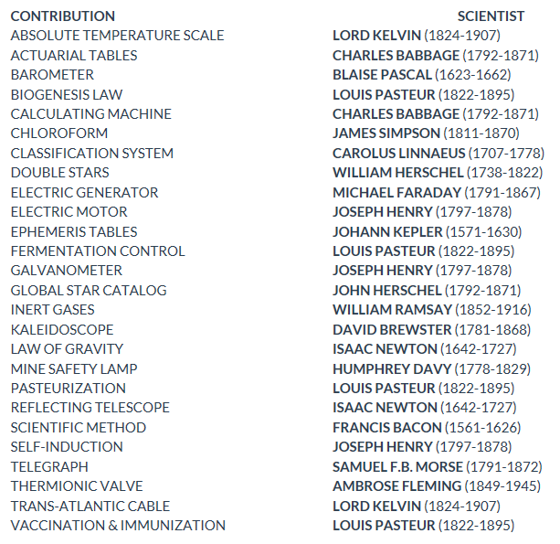
Creationist Scientists
Notes:
This second list contains notable inventions, discoveries, or developments by creationist scientists that have led to so many advancements in knowledge. Again, we’ll look at a few of them in more detail in just a few minutes.

Slide 21
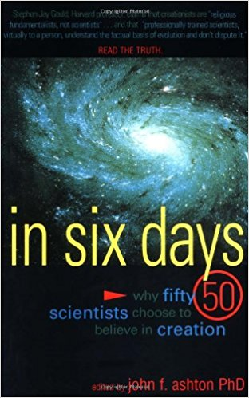
Creationist Scientists
Biology
Physics
Mathematics
Biochemistry
Organic Chemistry
Horticulture
Meteorology
Information Science
Zoology
Nuclear Physics
Notes:
This is a book called “In Six Days: Why Fifty Scientists Choose to Believe in Creation” by John F. Ashton.
The scientists in this book come from a plethora of backgrounds: biology, physics, mathematics, biochemistry, organic chemistry, horticultural science, meteorology, information science, zoology, nuclear physics, etc. In other words, there are people within our society with credible, scientific backgrounds that not only believe in Creation, but the same Creation that we see being explained in Gen 1.

Slide 22
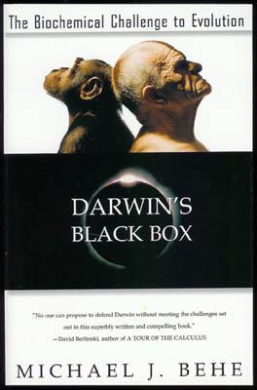
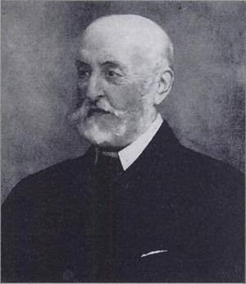
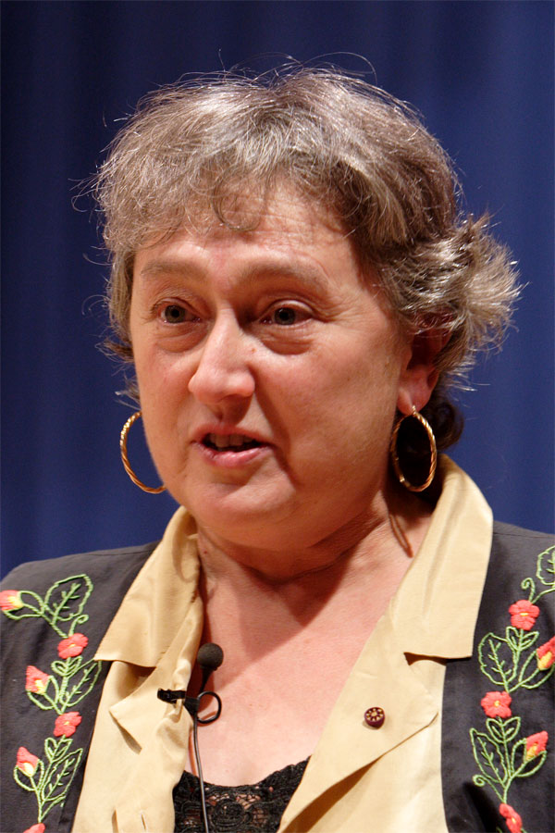
Creationist Scientists
“From Mivart to Margulis, there have always been well-informed, respected scientists who have found Darwinism to be inadequate.” – Michael J. Behe, author of “Darwin’s Black Box” (page 30).
Notes:
This is the book “Darwin’s Black Box” written by Michael Behe. This is the author and book which first began using the phrase “irreducible complexity” that I frequently site in my other series on Christian Evidences. Behe argues for irreducibly complex designs that we see in biochemical systems that could have only been the result of Intelligent Design rather than random, evolutionary processes. Here is a quote from this book:
“From Mivart to Margulis, there have always been well-informed, respected scientists who have found Darwinism to be inadequate.”
What does he mean by “From Mivart to Margulis”?
George Jackson Mivart was the man who lived in Charles Darwin’s time who was one of the very first men to staunchly oppose Darwinism. He was a medical doctor and he had a PHD. Interestingly, Darwin only had a bachelor’s degree in Theology. He was not an accredited scientist like these other guys we’ve been talking about….not that that’s a bad thing, but we have somehow managed to invent an entire scientific philosophy around this man’s idea while the PHD’s and the medical doctors were not listened to at the time. Let that sink in.
Lynn Margulis used to be married to Carl Sagan, did not believe in genetic evolution based on gene mutation and went on to say that she believed that Darwinism would eventually be known as a minor 20th century religious sect. She went on to say that Darwinists “wallow in their zoological, capitalistic, competitive, cost-benefit interpretation of Darwin.” She then went on to say “Neo-Darwinism, which insists on [the slow accrual of mutations by gene-level natural selection], is in a complete funk.” Now she was an Evolutionist and she said this.

Slide 23
Creationist Scientists
Notes:
This is a page I copied online from a 2001 online petition called “A Scientific Dissent From Darwinism”. Now, in order to get your name on this list, you have to have a PHD or an MD, and if you have an MD you have to be a professor to sign it. This is only page 1/23 pages of signers, of almost 1000 scientists from around the world who believe that Darwinian Theory is complete garbage.
So what then should our answer be when someone says, “There are no true scientists who deny Evolution”? There are scientists from all 8 ivy league schools on this list; scientists from Stanford, Duke, Rice, Emory, Carnegie Melon, Cal Tech, Johns Hopkins, and Vanderbilt.
Do these scientists not carry any weight? Intellectuals and scholars in the highest levels of their field reject Darwinian Evolution. Don’t ever let anyone tell you that there are no credible scientists that reject Darwinian Evolution.

Slide 24
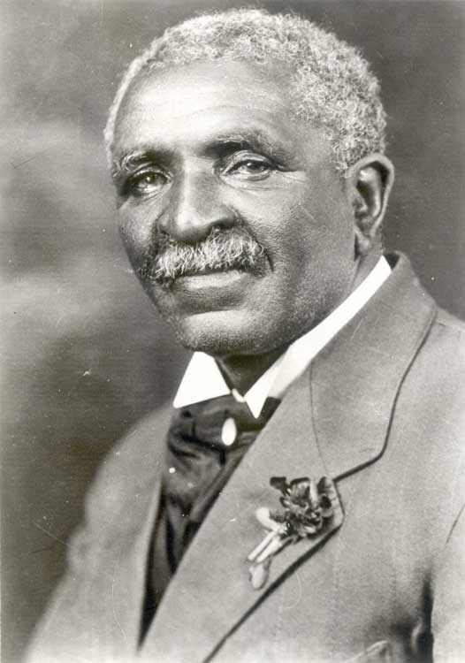
Creationist Scientists
“Nature is an unlimited broadcasting station through which God speaks to us every hour—if we will only tune in.” (How to Search for Truth,1930)
“God made the clay in the hills; they have been there for countless generations, changeless. All I do is prepare what God has made, for uses to which man can put it. It is God's work—not mine.” (George Washington Carver, Gene Adair, pp. 82, 83)
Notes:
George Washington Carver
He was born into slavery, self-educated, and eventually earned his Masters in Botany and taught for 47 years at Tuskegee Institute just down the road on I-85. At Tuskegee, he discovered hundreds of uses for agricultural products, pioneering food science with things such as cotton, sweet potatoes, and peanuts. He was an incredible scientist. He’s famous for a reason.
However nobody ever talks about the fact that he was a Creationist. We’re never told that every Sunday afternoon, he would hold lectures like we are having right now on science and the bible and how they agree with one another. And though he discovered incredible, monumental things, all throughout his writings he gives all the credit and the glory to God.

Slide 25
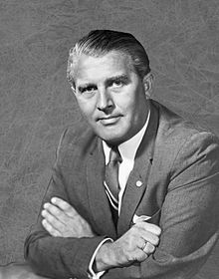
Creationist Scientists
“The primary resistance to acknowledging the “Case for Design” as a viable scientific alternative to the current “Case for Chance” lies in the inconceivability, in some scientists’ minds, of a Designer. The inconceivability of some ultimate issue…should not be allowed to rule out any theory that explains the interrelationship of observed data….[He added that] many intelligent men say they cannot visualize a Designer. Well, can a physicist visualize an electron? The electron is materially inconceivable and yet, it is so perfectly known through its effects that we use it to illuminate our cities [and] guide our airliners....What strange rationale makes some physicists accept the inconceivable electron as real while refusing to accept the reality of a Designer on the ground that they cannot conceive Him?…Although they really do not understand the electron either, they are ready to accept it because they managed to produce a rather clumsy mechanical model of it.^{” (}Seagraves, Jesus Christ Creator, 8-9.)
Notes:
Wernher von Braun
This guy did more to bring us into the space age than any other scientist. Developed the rockets for NASA for the Apollo space program that first landed man on the moon.
He originally worked for Hitler, but Hitler’s people put him in jail because he wanted to build rockets to go to the moon and not rockets to bomb London.
When he was released, he became a believer in God and became a strong advocate for the Christian faith and Creationism, writing and speaking extensively on the subject.

Slide 26
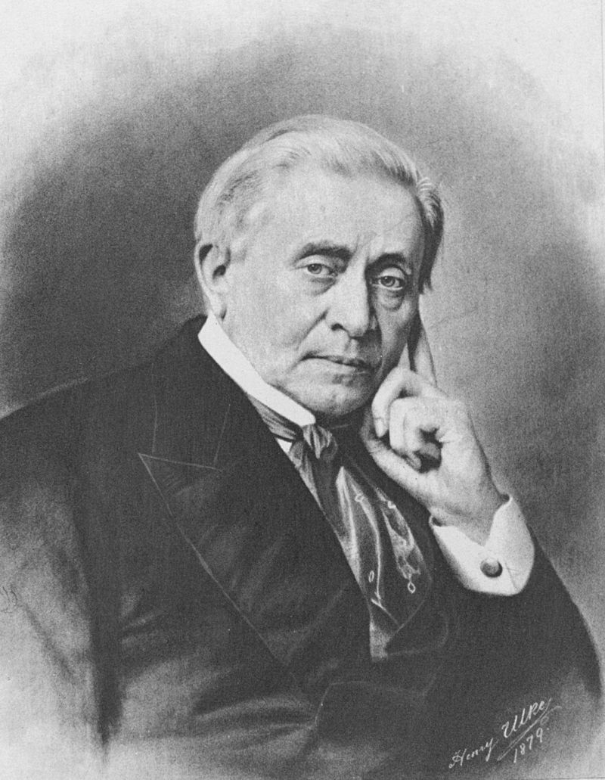
Creationist Scientists
“A universe without law would be a universe without order, without the possibility of science, and the manifestations of an intelligent governor and creator.” (Presidential address to the American Association for the Advancement of Science, 22 Aug 1850,The Papers of Joseph Henry, Vol. 8, 99)
“Nothing can be unworthy of being investigated by man, which was thought worthy of being created by God.” (In 'Report of the Secretary', Seventh Annual Report of the Board of Regents of the Smithsonian Institution for 1852, 1853, 15.)
Notes:
Joseph Henry
Discovered the phenomenon of self-inductance due to electromagnetism and was the first secretary of the Smithsonian Institute. He was a strong believer in God who thought the natural laws and order of the Universe could be attributed to no other source than a Divine Creator. He staunchly believed the Biblical Creation story.

Slide 27
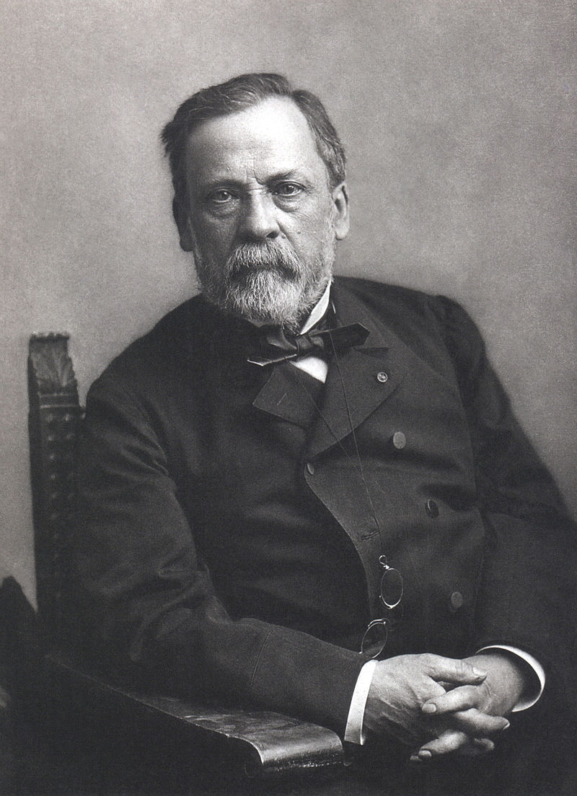
Creationist Scientists
“The more I study nature, the more I stand amazed at the work of the Creator. I pray while I am engaged at my work in the laboratory.” (The Literary Digest, 18 October 1902)
“Science brings men nearer to God” (As quoted in Letter to an Atheist, 2007, by Michael Patrick Leahy, p. 61)
Notes:
Louis Pasteur
The father of pasteurization. This guy was a staunch opponent of Darwinian Evolution and he disproved spontaneous generation, that is the idea that life just arrives out of nowhere. He was the one to prove that you have to have life to produce life and since this discovery, no Evolutionists has been able to disprove it.
What makes him even more impressive is that his life was punctuated by tragedy. 3 of his 5 children died of childhood diseases and he had a sister who was mentally retarded because of childhood disease. He himself was suffered from a severe brain hemorrhage and several strokes which left him partially paralyzed. Yet throughout all of this, he was man of faith who saw no conflict between science and Christianity.

Slide 28
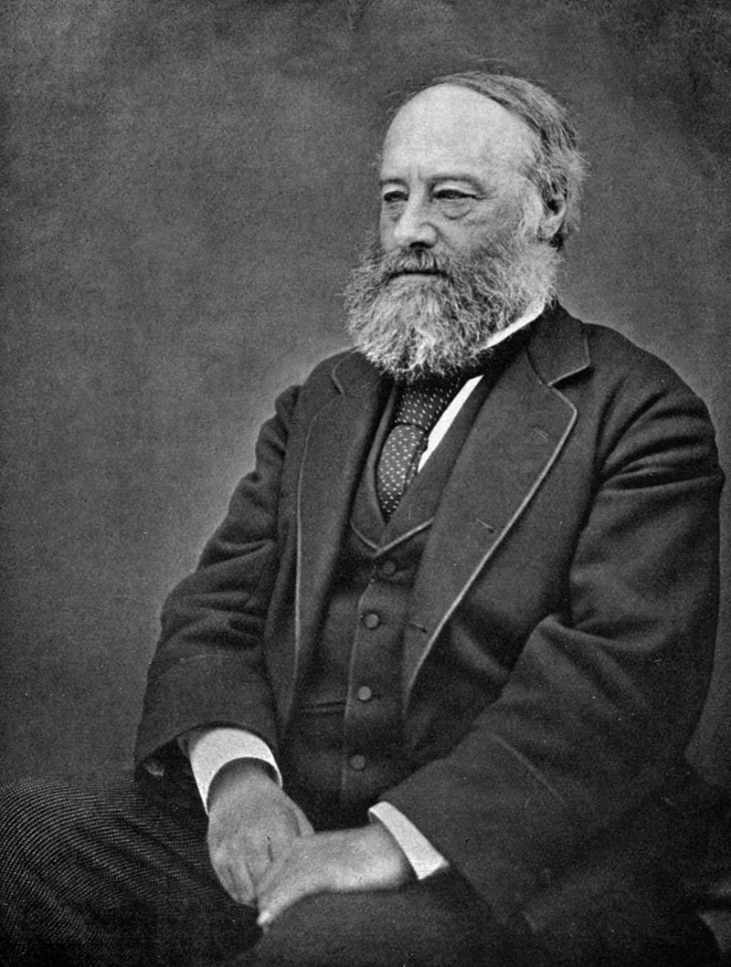
Creationist Scientists
“It is evident that an acquaintance with natural laws means no less than an acquaintance with the mind of God therein expressed.” (J.P. Joule, in a paper found with his scientific notebooks, as cited in: J.G. Crowther, British Scientists of the Nineteenth Century, Routledge & Kegan Paul, London, 1962, p. 139.)
Notes:
James Joule
This is the father of thermodynamics. He saw his desire to study science as a natural consequence of his Christian faith, not contrary to it. He saw no contradiction between his work as a scientist and his confidence in the truth of the Bible and many of his fellow scientists shared his views.
In response to the tide of Darwinism that was sweeping Europe, 717 scientists signed a remarkable manifesto entitled The Declaration of Students of the Natural and Physical Sciences, issued in London in 1864. This declaration affirmed their confidence in the scientific integrity of the Holy Scriptures. The list included 86 Fellows of the Royal Society.”
James Joule was among the more prominent of the scientists who signed the document.

Slide 29
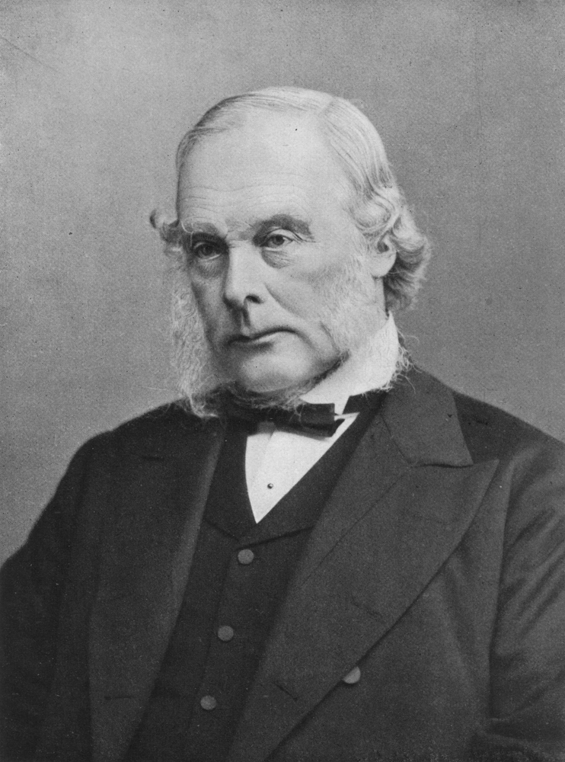
Creationist Scientists
“I am a believer in the fundamental doctrines of Christianity” (H.M. Morris, Men of Science, Men of God. Master Books, El Cajon, California, 1982, p. 67.)
Notes:
Joseph Lister
Father of antiseptic surgery in an age when hygienic conditions were just deplorable. Lister was an obstetrician, and in that day in London they would go from birth to birth without washing their hands and a high percentage of women giving birth in London at that time died of septicemic infections because the doctors weren’t washing their hands. Lister told them they needed to wash their hands under running water and he was scorned and mocked and shamed like you wouldn’t believe but that didn’t stop him. He went on to invent a whole bunch of phenols that kill germs and bacteria. Anybody know what household product was named after him? Listerine and there is also a bacteria named after him called “listeria”. This guy did more to save lives in the hospital than any other industry – and he was a believer.

Slide 30
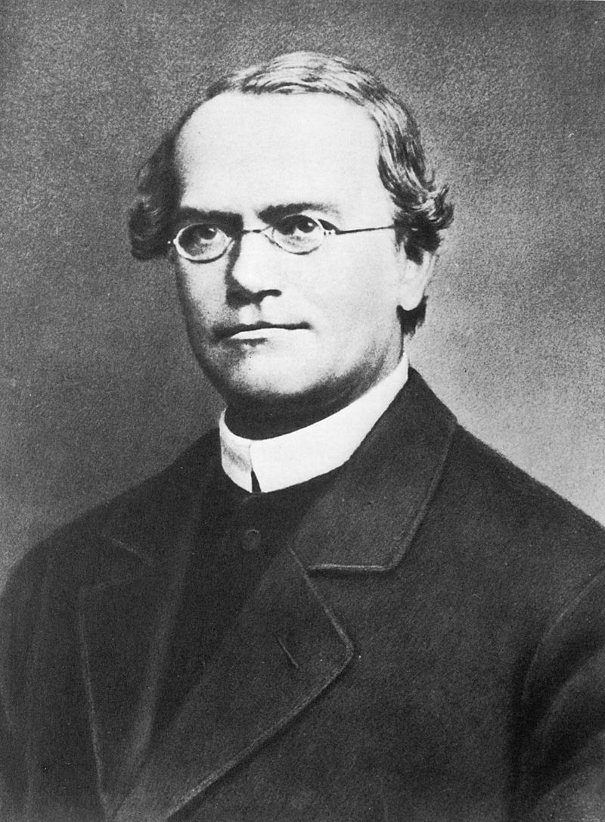
Creationist Scientists
“Jesus appeared to the disciples after the resurrection in various forms. He appeared to Mary Magdalene so that they might take him for a gardener. Very ingeniously these manifestation of Jesus is to our minds difficult to penetrate. (He appears) as a gardener. The gardener plants seedlings in prepared soil. The soil must exert a physical and chemical influence so that the seed of the plant can grow. Yet this is not sufficient. The warmth and light of the sun must be added, together with rain, in order that growth may result. The seed of supernatural life, of sanctifying grace, cleanses from sin, so preparing the soul of man, and man must seek to preserve this life by his good works. He still needs the supernatural food, the body of the Lord, which received continually, develops and brings to completion of the life. So natural and supernatural must unite to the realization of the holiness to the people. Man must contribute his minimum work of toil, and God gives the growth. Truly, the seed, the talent, the grace of God is there, and man has simply to work, take the seeds to bring them to the bankers. So that we “may have life, and abundantly“.
Notes:
Gregor Mendel
Remember this guy, because we’re going to discuss him later. Unfortunately, Darwin got all the press in 1859 but this guy, around the same time, came up with the idea of inheritable genetics, which overturned Lamarckianism. However, at the time, it was a very deep, mathematical science and so a lot of people either didn’t read it, didn’t understand it, or just disregarded it for its complexity. Some historians say that Mendel sent his paper to Darwin but that Darwin dismissed it because he either didn’t understand it or didn’t appreciate it (remember, Darwin only had a Bachelor’s degree in Theology).
But Mendel was a Creationist who believed the bible was the inspired word of God and he brought more good into the world through the discovery of genes, DNA, PCR, gene therapy, etc. – we’re living in an age of genetic revolution thanks to this guy. But there are many who suggest that Darwinism actually set back biological science 20 – 30 years – so much emphasis on it was stressed that other science such as Gregor Mendel’s ideas were suppressed when they could have been helping a lot of people.

Slide 31
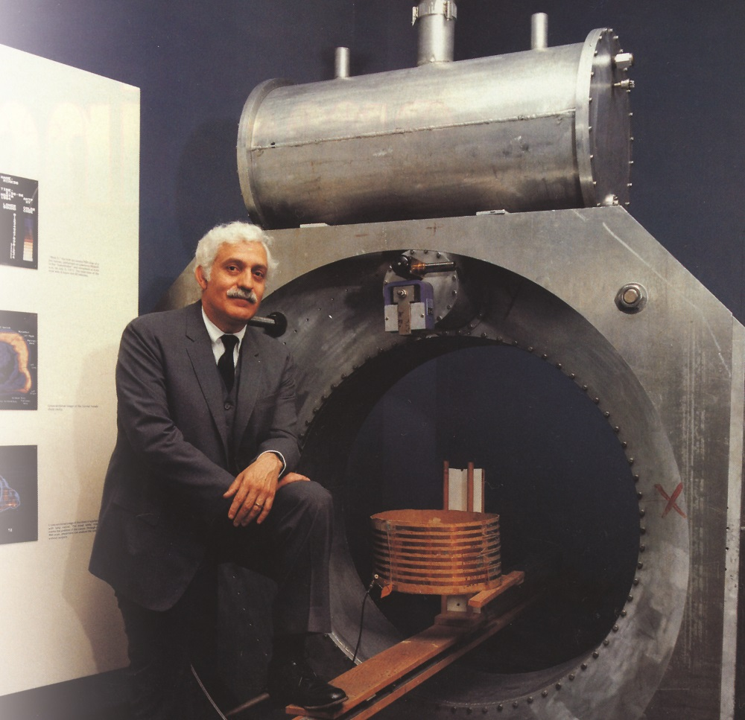
Creationist Scientists
“For me, my greatest single discovery in life was not a machine or a physical principle. My highest purpose was realized when I discovered I could actually know God and serve His will, that I could live for something greater than science, medicine, or myself.”
Notes:
Raymond Damadian
He invented the MRI and is an intelligent design advocate. He signed the list we looked earlier of scientists who dissented from Darwinism. He was also nominated for a Nobel Prize, but he did not get it and there is strong speculation that the reason he didn’t get it is because he is an intelligent design advocate. And if you go back and compare his scientific accomplishments to others who received the Nobel Prize, his is much more significant than many. You should google details about this online, it is really interesting.

Slide 32
Notes:
So Evolutionists have the same evidence. Yet accomplished scientists disagree on how to interpret the evidence. What is the issue? The main issue, IMHO, is having an open heart that diligently and unbiasedly seeks the answer, no matter what that answer may be. And in order to have that kind of heart, we have to watch over it and protect it from being polluted by pride, intimidation, or bitterness. As we’ll discuss in our next lesson, there are many people, I dare say the majority of people, who believe in Evolution not because the evidence outweighs creationism, but for other motives.

Slide 33
Notes:
Why am I bringing up these Creationist scientists? Certainly not so we will put our faith in them – our faith needs to be in God’s word. It is simply to show that Creationism/Christianity is not anti-science, and that many of the world’s greatest scientists believe in a young earth and reject Darwinian Evolution.
But our faith must go deeper than the science – God’s word. We want to be the guy that says, “The bible is right and I can show you!”
An important question to ask – do we believe what we do about Evolution, whether we’re for it or against it, because of what God’s word says or because of what scientists say? Because the goal of this series of lessons is to show you that the evidence for God and Creationism is far stronger than the evidence for Evolution. And the only reason I want to ever look at science as a positive affirmation for Creationism is to show how it fits with what God’s word reveals.
1 Pet 3:15 – “But sanctify Christ as Lord in your hearts, always being ready to make a defense to everyone who asks you to give an account for the hope that is in you, yet with gentleness and reverence”

